Slide 1
Ch 23
Measuring a Nation’s Income

Slide 2
Look for the answers to these questions:
What is Gross Domestic Product (GDP)?
How is GDP related to a nation’s total income and spending?
What are the components of GDP?
How is GDP corrected for inflation?
Does GDP measure society’s well-being?

Slide 3
Economics
Microeconomics
Study of how households and firms
Make decisions
Interact in markets
Macroeconomics
Study of economy-wide phenomena
Including inflation, unemployment, and economic growth

Slide 4
Income and Expenditure
Gross Domestic Product (GDP)
Measures total income of everyone in the economy.
Also measures total expenditure on the economy’s output of goods and services.
Income equals expenditure
For the economy as a whole
Because every dollar a buyer spends is a dollar of income for the seller.

Slide 5
The Circular-Flow Diagram
The Circular-Flow Diagram
Simple depiction of the macroeconomy
Illustrates GDP as spending, revenue, factor payments, and income
Preliminaries:
Factors of production are inputs like labor, land, capital, and natural resources.
Factor payments are payments to the factors of production (e.g., wages, rent).

Slide 6
The Circular-Flow Diagram
Households:
own the factors of production, sell/rent them to firms for income
buy and consume goods & services
Firms
Households
Firms:
buy/hire factors of production, use them to produce goods and services
sell goods & services
Notes:
6
This and the following slide build the Circular-Flow Diagram piece by piece.

Slide 7
The Circular-Flow Diagram
Revenue (=GDP)
Spending (=GDP)
Markets for Goods & Services
G & S sold
G & S bought
Firms
Households
Factors of production
Labor, land, capital
Markets for Factors of Production
Wages, rent, profit (=GDP)
Income (=GDP)
Notes:
7
In this diagram, the green arrows represent flows of income/payments. The red arrows represent flows of goods & services (G&S) (including services of the factors of production in the lower half of the diagram).
To keep the graph simple, we have omitted the government, financial system, and foreign sector, as discussed on the next slide.
Changing the animation on this slide:
If you wish, you can easily change the order in which the markets and arrows appear. From the “Slide Show” drop-down menu, choose “Custom Animation…” Then, a box will appear (maybe along the right-hand-side of your PowerPoint window) that allows you to modify the order in which things appear (as well as other aspects of the animation). For further information, open PowerPoint help and search on “change the sequence of animations.”

Slide 8
What This Diagram Omits
The government
Collects taxes, buys goods and services
The financial system
Matches savers’ supply of funds with borrowers’ demand for loans
The foreign sector
Trades goods and services, financial assets, and currencies with the country’s residents

Slide 9
Gross Domestic Product (GDP) Is…
…the market value of all final goods & services produced within a country in a given period of time.
Goods are valued at their market prices, so:
All goods measured in the same units (e.g., dollars in the U.S.)
Things that don’t have a market value are excluded, e.g., housework you do for yourself.

Slide 10
Gross Domestic Product (GDP) Is…
…the market value of all final goods & services produced within a country in a given period of time.
GDP includes all items produced in the economy and sold legally in markets
GDP excludes most items produced and sold illicitly. It also excludes most items that are produced and consumed at home.
Notes:
x

Slide 11
Gross Domestic Product (GDP) Is…
…the market value of all final goods & services produced within a country in a given period of time.
Final goods: intended for the end user
Intermediate goods: used as components or ingredients in the production of other goods
GDP only includes final goods—they already embody the value of the intermediate goods used in their production.
Notes:
x

Slide 12
Gross Domestic Product (GDP) Is…
…the market value of all final goods & services produced within a country in a given period of time.
GDP includes tangible goods (like DVDs, mountain bikes, beer)
and intangible services (dry cleaning, concerts, cell phone service).
Notes:
x

Slide 13
Gross Domestic Product (GDP) Is…
…the market value of all final goods & services produced within a country in a given period of time.
GDP includes currently produced goods, not goods produced in the past.

Slide 14
Gross Domestic Product (GDP) Is…
…the market value of all final goods & services produced within a country in a given period of time.
GDP measures the value of production that occurs within a country’s borders, whether done by its own citizens or by foreigners located there.

Slide 15
Gross Domestic Product (GDP) Is…
…the market value of all final goods & services produced within a country in a given period of time.
Usually a year or a quarter (3 months)

Slide 16
The Components of GDP
Recall: GDP is total spending.
Four components:
Consumption (C)
Investment (I)
Government Purchases (G)
Net Exports (NX)
These components add up to GDP (denoted Y): Y = C + I + G + NX
Notes:
Each of the four components is defined and discussed in detail on the following slides.

Slide 17
Consumption (C)
Consumption, C
Total spending by households on goods and services
Note on housing costs:
For renters, C includes rent payments.
For homeowners, C includes the imputed rental value of the house, but not the purchase price or mortgage payments
Not included in C: purchases of new housing

Slide 18
Investment (I)
Investment, I
Total spending on goods that will be used in the future to produce more goods
Business capital: business structures, equipment, and intellectual property products
Residential capital: landlord’s apartment building; a homeowner’s personal residence
Inventory accumulations: goods produced but not yet sold
“Investment” does not mean the purchase of financial assets like stocks and bonds.

Slide 19
Government Purchases (G)
Government purchases (G)
All spending on the goods and services purchased by the government
At the federal, state, and local levels.
Excludes transfer payments
Such as Social Security or unemployment insurance benefits.
They are not purchases of goods and services

Slide 20
Net Exports (NX)
Net exports, NX = exports – imports
Exports: foreign spending on the economy’s goods and services
Imports: are the portions of C, I, and G that are spent on goods and services produced abroad
Adding up all the components of GDP gives:
Y = C + I + G + NX

Slide 21
U.S. GDP and Its Components, 2015
 | Billions | % of GDP | Per capita
Y | $17,947 | 100.0 | $55,426
C | 12,272 | 68.4 | 37,899
I | 3,021 | 16.8 | 9,330
G | 3,183 | 17.7 | 9,830
NX | -529 | -2.9 | -1,634
Notes:
Source for data on GDP & components: https://fred.stlouisfed.org/series/PCECA: Table 1.1.5
Source for population data (used to calculate the per capita figures): http://research.stlouisfed.org/fred2/series/POPTHM?cid=104 (
Original source: U.S. Department of Commerce: Census Bureau, www.census.gov

Slide 22
Active Learning 1 GDP and its components
In each of the following cases, determine how much GDP and each of its components is affected (if at all).
Debbie spends $300 to buy her husband dinner at the finest restaurant in Boston.
Sarah spends $1200 on a new laptop to use in her publishing business. The laptop was built in China.
Jane spends $800 on a computer to use in her editing business. She got last year’s model on sale for a great price from a local manufacturer.
General Motors builds $500 million worth of cars, but consumers only buy $470 million worth of them.

Slide 23
Active Learning 1
Debbie spends $300 to buy her husband dinner at the finest restaurant in Boston.
Sarah spends $1200 on a new laptop to use in her publishing business. The laptop was built in China.

Slide 24
Active Learning 1
Debbie spends $300 to buy her husband dinner at the finest restaurant in Boston.
Consumption and GDP rise by $300.
Sarah spends $1200 on a new laptop to use in her publishing business. The laptop was built in China.

Slide 25
Active Learning 1
Debbie spends $300 to buy her husband dinner at the finest restaurant in Boston.
Consumption and GDP rise by $300.
Sarah spends $1200 on a new laptop to use in her publishing business. The laptop was built in China.
Investment rises by $1200, net exports fall by $1200, GDP is unchanged.

Slide 26
Active Learning 1
Jane spends $800 on a computer to use in her editing business. She got last year’s model on sale for a great price from a local manufacturer.
General Motors builds $500 million worth of cars, but consumers only buy $470 million of them.
Notes:
Regarding part C:
Jane’s purchase causes investment (for her own business) to increase by $800. However, the computer is sold out of inventory, so inventory investment falls by $800. The two transactions cancel each other, leaving aggregate investment and GDP unchanged.
Regarding part D:
This problem illustrates why expenditure always equals output, even when firms don’t sell everything they produce due to lackluster demand. The point here is that unsold output is counted in inventory investment, even when that “investment” was unintentional.

Slide 27
Active Learning 1
Jane spends $800 on a computer to use in her editing business. She got last year’s model on sale for a great price from a local manufacturer.
Current GDP and investment do not change, because the computer was built last year.
General Motors builds $500 million worth of cars, but consumers only buy $470 million of them.
Notes:
Regarding part C:
Jane’s purchase causes investment (for her own business) to increase by $800. However, the computer is sold out of inventory, so inventory investment falls by $800. The two transactions cancel each other, leaving aggregate investment and GDP unchanged.
Regarding part D:
This problem illustrates why expenditure always equals output, even when firms don’t sell everything they produce due to lackluster demand. The point here is that unsold output is counted in inventory investment, even when that “investment” was unintentional.

Slide 28
Active Learning 1
Jane spends $800 on a computer to use in her editing business. She got last year’s model on sale for a great price from a local manufacturer.
Current GDP and investment do not change, because the computer was built last year.
General Motors builds $500 million worth of cars, but consumers only buy $470 million of them.
Consumption rises by $470 million, inventory investment rises by $30 million, and GDP rises by $500 million.

Slide 29
Real versus Nominal GDP
Nominal GDP
Values output using current prices
Not corrected for inflation
Real GDP
Values output using the prices of a base year
Is corrected for inflation
For the base year
Nominal GDP = Real GDP

Slide 30
EXAMPLE:
Compute nominal GDP in each year:
2014: $10 x 400 + $2 x 1000 = $6,000
2015: $11 x 500 + $2.50 x 1100 = $8,250
2016: $12 x 600 + $3 x 1200 = $10,800
Increase:
37.5%
30.9%
 | Pizza |  | Latte
year | P | Q | P | Q
2014 | $10 | 400 | $2.00 | 1000
2015 | $11 | 500 | $2.50 | 1100
2016 | $12 | 600 | $3.00 | 1200
Notes:
30

Slide 31
EXAMPLE:
Compute real GDP in each year, using 2014 as the base year:
2014: $10 x 400 + $2 x 1000 = $6,000
2015: $10 x 500 + $2 x 1100 = $7,200
2016: $10 x 600 + $2 x 1200 = $8,400
 | Pizza |  | Latte
year | P | Q | P | Q
2014 | $10 | 400 | $2.00 | 1000
2015 | $11 | 500 | $2.50 | 1100
2016 | $12 | 600 | $3.00 | 1200
$10
$2.00
Increase:
20.0%
16.7%
Notes:
31

Slide 32
EXAMPLE:
year | Nominal GDP |  | Real GDP
2014 | $6000 |  | $6000
2015 | $8250 |  | $7200
2016 | $10,800 |  | $8400
In each year,
nominal GDP is measured using the (then) current prices.
real GDP is measured using constant prices from the base year (2014 in this example).
Notes:
32

Slide 33
EXAMPLE:
The change in nominal GDP reflects both prices and quantities.
The change in real GDP is the amount that GDP would change if prices were constant (i.e., if zero inflation).
Hence, real GDP is corrected for inflation.
year | Nominal GDP |  | Real GDP
2014 | $6000 |  | $6000
2015 | $8250 |  | $7200
2016 | $10,800 |  | $8400
37.5%
20.0%
30.9%
16.7%
Notes:
33

Slide 34
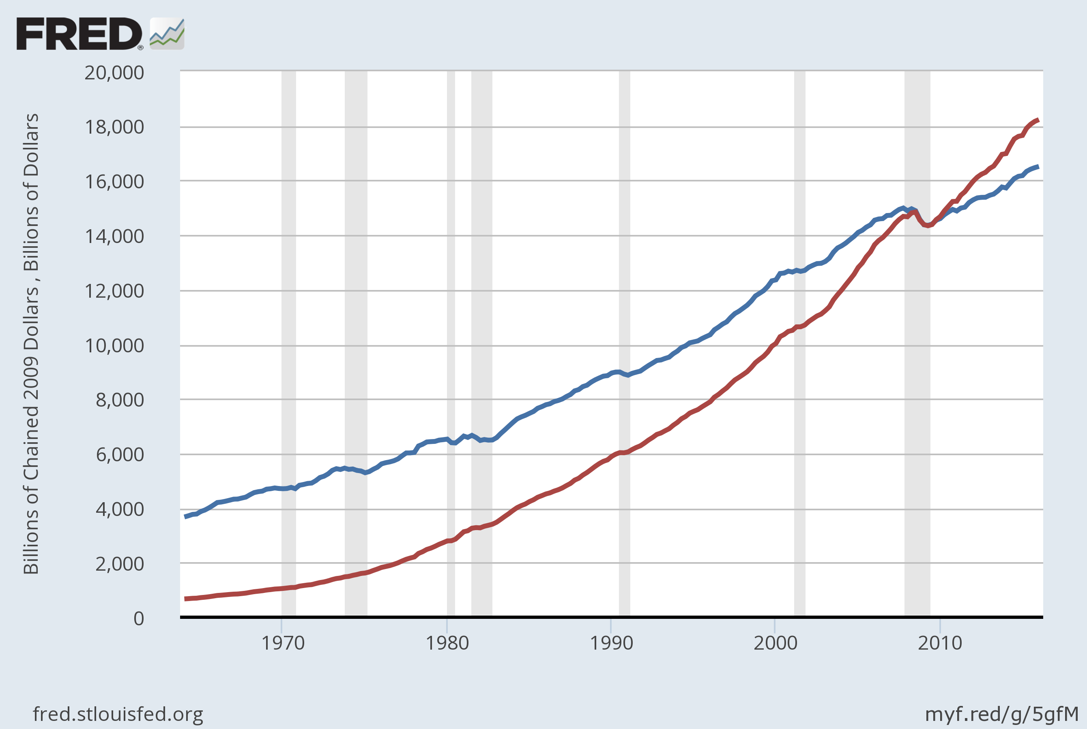
Nominal and Real GDP in the U.S., 1965–2015
Real GDP (base year 2009)
Nominal GDP
Notes:
Source: US. Bureau of Economic Analysis, retrieved from FRED, Federal Reserve Bank of St. Louis
Real Gross Domestic Product [GDPC1]; https://fred.stlouisfed.org/series/GDPC1, July 7, 2016. Gross Domestic Product [GDP], https://fred.stlouisfed.org/series/GDP, July 7, 2016.

Slide 35
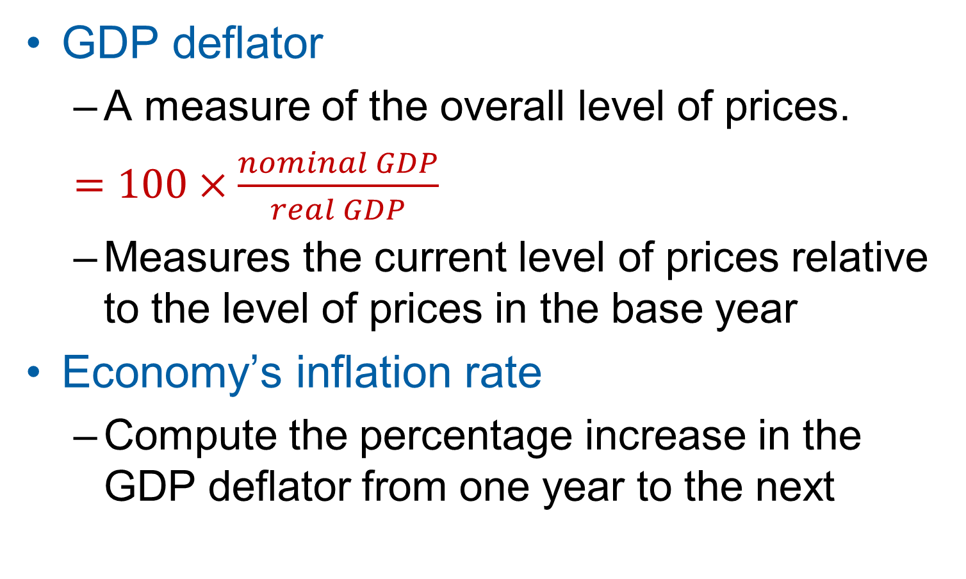
The GDP Deflator
GDP deflator
A measure of the overall level of prices.
$=100×\frac{nominal GDP}{real GDP}$
Measures the current level of prices relative to the level of prices in the base year
Economy’s inflation rate
Compute the percentage increase in the GDP deflator from one year to the next
Notes:
For the base year, the GDP deflator is 100.

Slide 36
EXAMPLE:
Compute the GDP deflator in each year:
2014: 100 x (6000/6000) = 100
2015: 100 x (8250/7200) = 114.6
2016: 100 x (10,800/8400) = 128.6
year | Nominal GDP | Real GDP | GDP Deflator
2014 | $6000 | $6000
2015 | $8250 | $7200
2016 | $10,800 | $8400
100.0
14.6%
114.6
12.2%
128.6
Notes:
36

Slide 37
Active Learning 2 Computing GDP
 | 2014 (base year) |  | 2015 |  | 2016
 | P | Q | P | Q | P | Q
Good A | $30 | 900 | $31 | 1000 | $36 | 1050
Good B | $100 | 192 | $102 | 200 | $100 | 205
Use the above data to solve these problems:
Compute nominal GDP in 2014.
Compute real GDP in 2015.
Compute the GDP deflator in 2016.

Slide 38
Active Learning 2 Computing GDP
 | 2014 (base year) |  | 2015 |  | 2016
 | P | Q | P | Q | P | Q
Good A | $30 | 900 | $31 | 1000 | $36 | 1050
Good B | $100 | 192 | $102 | 200 | $100 | 205
Compute nominal GDP in 2014.
Compute real GDP in 2015.

Slide 39
Active Learning 2 Computing GDP
 | 2014 (base year) |  | 2015 |  | 2016
 | P | Q | P | Q | P | Q
Good A | $30 | 900 | $31 | 1000 | $36 | 1050
Good B | $100 | 192 | $102 | 200 | $100 | 205
Compute nominal GDP in 2014.
$30 x 900 + $100 x 192 = $46,200
Compute real GDP in 2015.

Slide 40
Active Learning 2 Computing GDP
 | 2014 (base year) |  | 2015 |  | 2016
 | P | Q | P | Q | P | Q
Good A | $30 | 900 | $31 | 1000 | $36 | 1050
Good B | $100 | 192 | $102 | 200 | $100 | 205
Compute nominal GDP in 2014.
$30 x 900 + $100 x 192 = $46,200
Compute real GDP in 2015.
$30 x 1000 + $100 x 200 = $50,000

Slide 41
Active Learning 2 Computing GDP
 | 2014 (base year) |  | 2015 |  | 2016
 | P | Q | P | Q | P | Q
Good A | $30 | 900 | $31 | 1000 | $36 | 1050
Good B | $100 | 192 | $102 | 200 | $100 | 205
Compute the GDP deflator in 2016.

Slide 42
Active Learning 2 Computing GDP
 | 2014 (base year) |  | 2015 |  | 2016
 | P | Q | P | Q | P | Q
Good A | $30 | 900 | $31 | 1000 | $36 | 1050
Good B | $100 | 192 | $102 | 200 | $100 | 205
Compute the GDP deflator in 2016.
Nom GDP = $36 x 1050 + $100 x 205 = $58,300
Real GDP = $30 x 1050 + $100 x 205 = $52,000

Slide 43
Active Learning 2 Computing GDP
 | 2014 (base year) |  | 2015 |  | 2016
 | P | Q | P | Q | P | Q
Good A | $30 | 900 | $31 | 1000 | $36 | 1050
Good B | $100 | 192 | $102 | 200 | $100 | 205
Compute the GDP deflator in 2016.
Nom GDP = $36 x 1050 + $100 x 205 = $58,300
Real GDP = $30 x 1050 + $100 x 205 = $52,000
GDP deflator = 100 x (Nom GDP)/(Real GDP)
= 100 x ($58,300)/($52,000) = 112.1

Slide 44
GDP and Economic Well-Being
Real GDP per capita
Main indicator of the average person’s standard of living
But GDP is not a perfect measure of well-being.
Robert Kennedy issued a very eloquent yet harsh criticism of GDP:

Slide 45
Senator Robert Kennedy, 1968 Gross Domestic Product…
“… does not allow for the health of our children, the quality of their education, or the joy of their play.
It does not include the beauty of our poetry or the strength of our marriages, the intelligence of our public debate or the integrity of our public officials.
It measures neither our courage, nor our wisdom, nor our devotion to our country.
It measures everything, in short, except that which makes life worthwhile, and it can tell us everything about America except why we are proud that we are Americans.”
Notes:
Very scathing words, indeed!

Slide 46
GDP Does Not Value:
The quality of the environment
Leisure time
Non-market activity, such as the child care a parent provides at home
An equitable distribution of income
Notes:
Much of what Robert Kennedy said about GDP is correct.

Slide 47
Then Why Do We Care About GDP?
Having a large GDP enables a country to afford
Better schools, a cleaner environment, health care, etc.
Many indicators of the quality of life are positively correlated with GDP. For example…
Notes:
Then why do we care about GDP?
Because a large GDP does in fact help us to lead a good life. GDP does not measure the health of our children, but nations with larger GDP can afford better health care for their children. GDP does not measure the beauty of our poetry, but nations with larger GDP can afford to teach more of their citizens to read and enjoy poetry. GDP does not take account of our intelligence, integrity, courage, wisdom, or devotion to country, but all of these laudable attributes are easier to foster when people are less concerned about being able to afford the material necessities of life.
In short, GDP does not directly measure those things that make life worthwhile, but it does measure our ability to obtain the inputs into a worthwhile life.

Slide 48
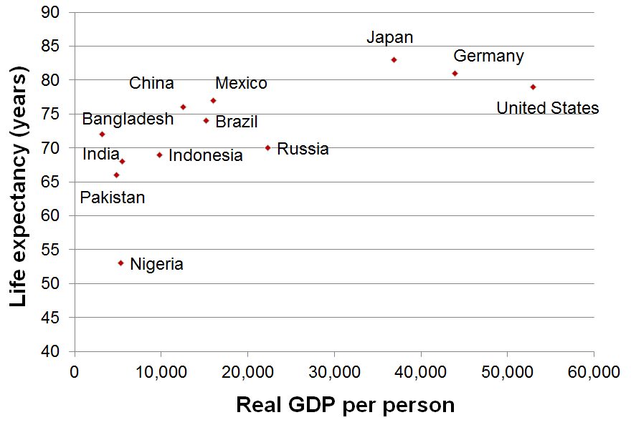
GDP and Life Expectancy in 12 countries
Notes:
This figure and the two that follow are from the data in Table 3 of the textbook.
Real GDP per capita figures are expressed in U.S. dollars.
Source: Human Development Report 2015, United Nations.
Real GDP is for 2014, expressed in 2011 dollars.

Slide 49
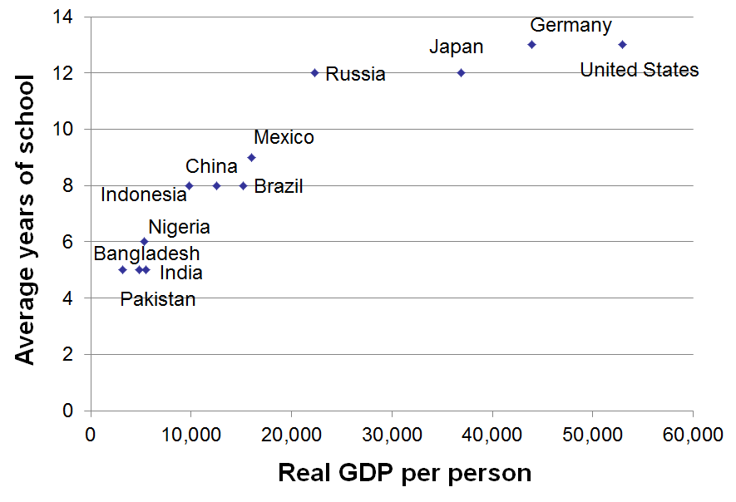
GDP and Average Schooling in 12 countries
Notes:
Source: Human Development Report 2015, United Nations.
Average years of schooling is among adults 25 and older.

Slide 50
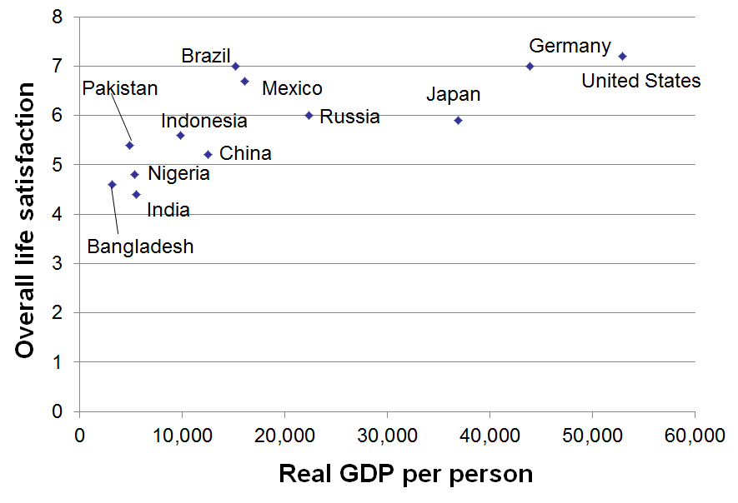
GDP and Overall Life Satisfaction (0 to 10 scale) in 12 countries
Notes:
Source: Human Development Report 2015, United Nations.
Overall life satisfaction on a 0 to 10 scale.

Slide 51
Summary
Gross Domestic Product (GDP) measures a country’s total income and expenditure.
The four spending components of GDP include: Consumption, Investment, Government Purchases, and Net Exports.
Nominal GDP is measured using current prices. Real GDP is measured using the prices of a constant base year and is corrected for inflation.
GDP is the main indicator of a country’s economic well-being, even though it is not perfect.

